Slide 1
Chapter 20

Slide 2
Objectives

Slide 3
Objectives (cont.)

Slide 4
The Products table

Slide 5
How a table is organized

Slide 6
The design of the Products table

Slide 7
Two related tables: Products and LineItems

Slide 8
How the tables in a database are related

Slide 9
SELECT syntax for selecting from one table

Slide 10
A SELECT statement that gets all columns and rows

Slide 11
A SELECT statement that gets selected columns and rows

Slide 12
SELECT syntax for joining two tables

Slide 13
A SELECT statement that doesn’t use table aliases

Slide 14
A SELECT statement that uses table aliases

Slide 15
How to work with aliases

Slide 16
How to add rows

Slide 17
How to update rows

Slide 18
How to delete rows

Slide 19
SQLite is…

Slide 20
Data types supported by SQLite

Slide 21
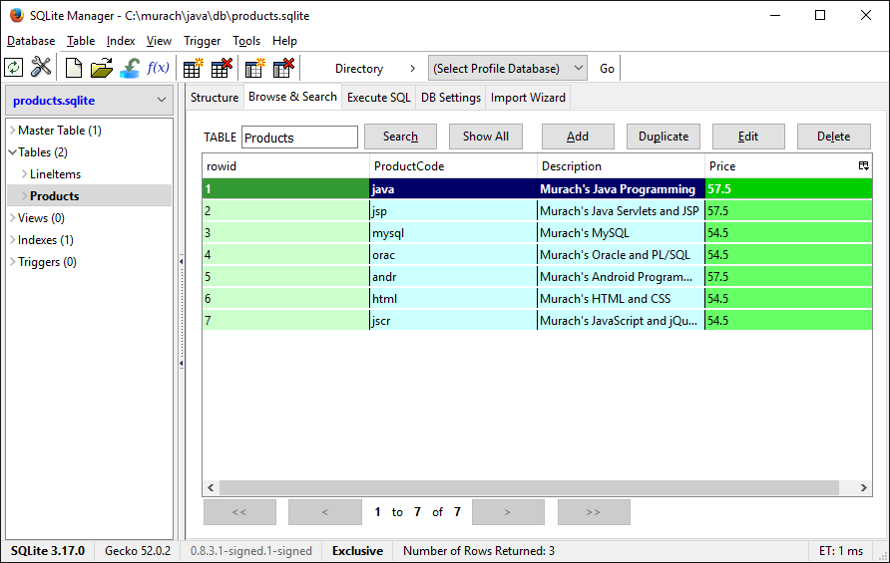
SQLite Manager after using Browse & Search to view a table

Slide 22
How to connect to a SQLite database

Slide 23
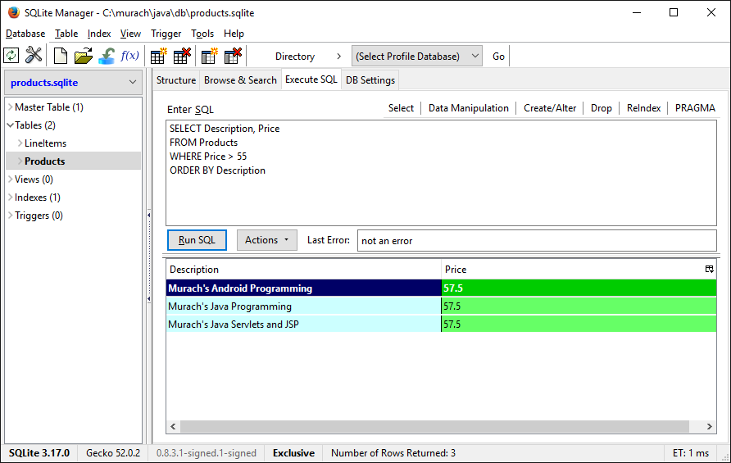
The Execute SQL tab after a SQL statement has been executed

Slide 24
A script that creates a SQLite database

Slide 25
A script that creates a SQLite database (cont.)

Slide 26
How to create a SQLite database

